Slide 1

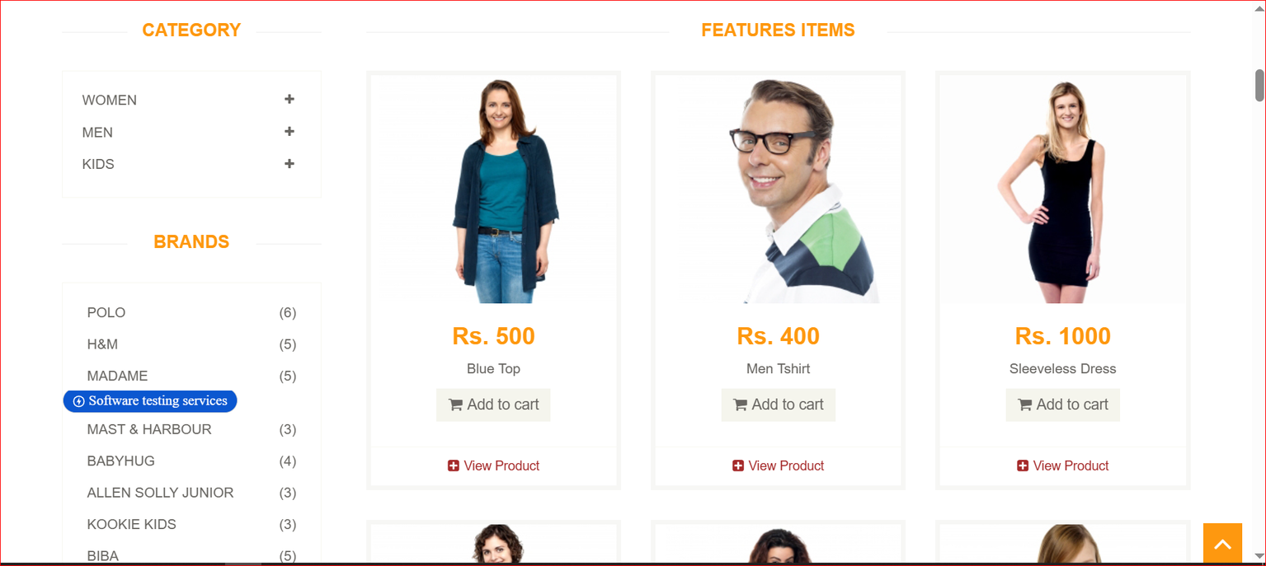


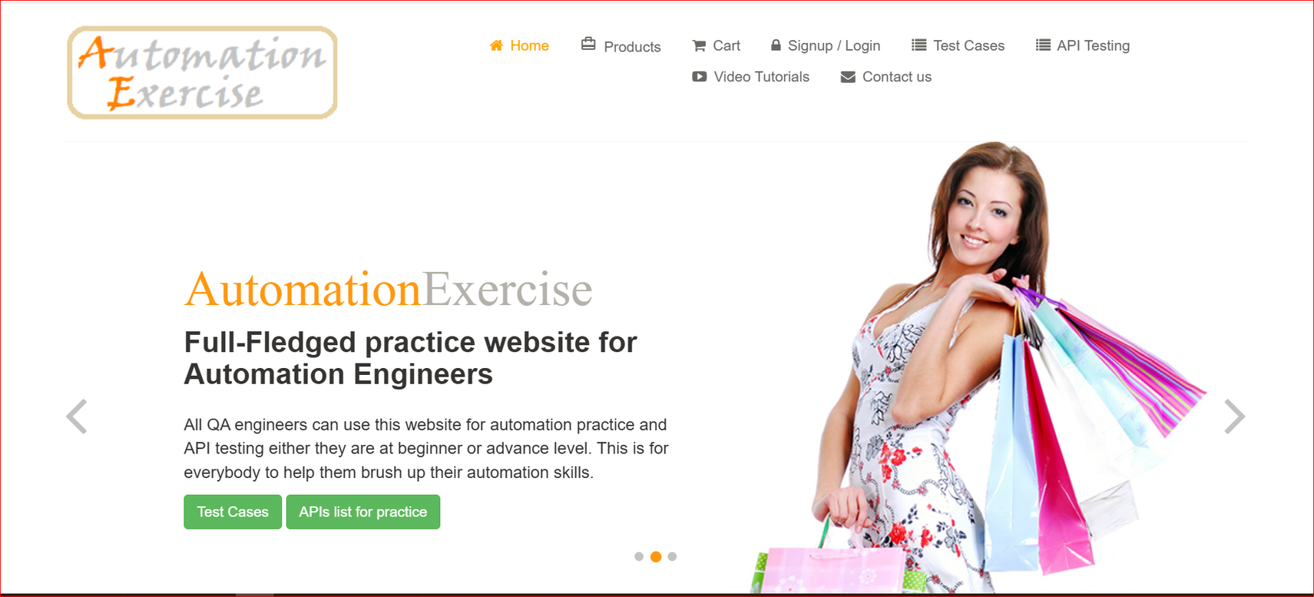
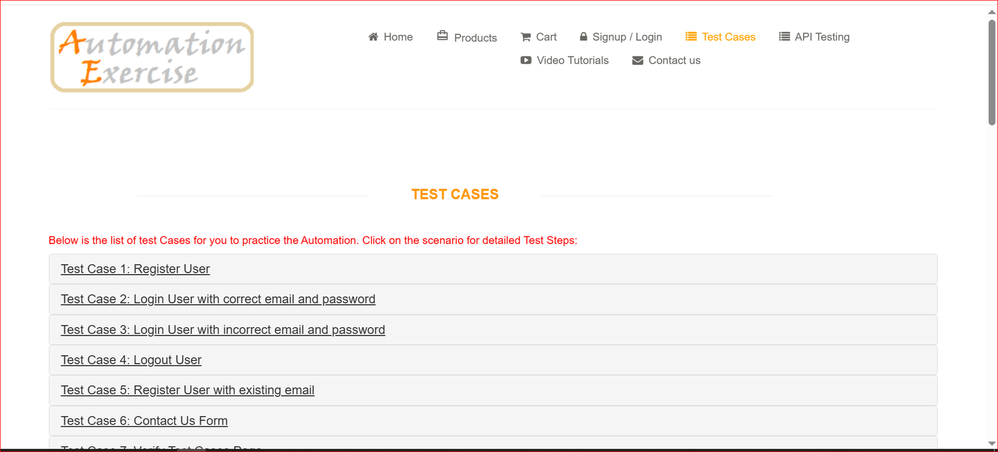

DEPI Egypt
Graduation Project Project
Automation Exercise website
Instructor : Abdulrhman Osama
Track : SoftwareTesting
group member :
Mohamed Mondy
Mohamed Ayman
Omar Ahmed
Mena Magdy
Mariam Darwish
Sosana Soliman

Slide 2





DEPI Egypt
Automation Exercise Website
Automation Exercise is a demo web application designed to provide a comprehensive platform for practicing and testing automation tools and techniques. It simulates real-world e-commerce functionalities such as user registration, login, product search, and purchase processes. The website serves as a practical environment for QA engineers and developers to implement and validate automated test scripts using tools like Selenium WebDriver, Postman, and testing frameworks such as Page Object Model (POM) and Data Driven Testing."

Slide 3





DEPI Egypt
Execute both manual and automated test cases
Detect and report bugs with detailed bug reports
Use Page Object Model (POM) to enhance code maintainability
Cover both happy and negative test scenarios
Perform API testing to ensure data consistency
Deliver professional documentation and test reports
Project Objectives

Slide 4






Tools & Technologies Used
automation testing
Manual Testing
Selenium WebDriver (UI Testing)
Java + Maven TestNG / JUnit (Testing Framework)
Eclipse IDE
Postman (API Testing)
Excel (Test Cases, Bug Reports)

Slide 5



Test Scenarios Covered
Register User (Manual + Automated)
Login (Valid & Invalid Scenarios)
Contact Us form submission
Product Search & Add to Cart
Checkout & Payment Process
Delete Account
API testing for Users, Products, Categories

Slide 6





Challenges Faced
Dynamic elements required custom locators
Repeated manual testing during regression
1
3
Synchronization issues (handled using waits)
Incomplete API documentation
2
4
5
Data management across tests

Slide 7





What Was Tested
We tested major functionalities of the website including:
User Registration & Login (Positive & Negative)
Product Search & Filtering
Contact Us form
Adding products to cart
Account Deletion
Checkout and payment process
API endpoints for users, products, categories

Slide 8




API Testing Overview
Methods: GET, POST, PUT, DELETE
Used Postman to test REST APIs
Validated response status codes and data accuracy
Included negative test cases (invalid data, error handling)

Slide 9
Test Coverage Results
Full manual test case coverage achieved
1
95% test scenarios automated successfully
3
2
Regression testing performed after each fix

Slide 10


Issues Found & Fixed
Error message not shown for invalid login
Add to cart not working for certain products
Contact form allowed blank submissions
Login with wrong credentials gives incorrect error message

Slide 11



Thank You
Trusted for smooth logistics

